Slide 1



Blue Team Summit & Training
Save the Date: April 23 - 30 Louisville, Kentucky
sans.org/BlueTeam
SEC530 – Defensible Security Architecture
SEC555 – SIEM with Tactical Analytics
SEC511 – Continuous Monitoring & Security Operations
MGT517 - Managing Security Operations
Cyber Defense NetWars
SUMMIT
April 23-24
TRAINING
April 25-30
sans.org/BlueTeam
Notes:
Drag Picture and Send to Back

Slide 2
SEC555
Presentation based on SEC555: SIEM with Tactical Analytics
One Detect to Win: Tactical Endpoint Detection
Justin Henderson (GSE # 108) @SecurityMapper and Stephen Mathezer

Slide 3


About Us
Justin Henderson
Author of SEC555: SIEM with Tactical Analytics
GIAC GSE # 108, Cyber Guardian Blue and Red
58 industry certifications (need to get a new hobby)
Stephen Mathezer
Anything you wish to call out # 1
Anything you wish to call out # 2
SANS instructor for (SEC511, SEC555, and ICS410)

Slide 4
Welcome!
A copy of this talk is available at: https://github.com/HASecuritySolutions/presentations
More free stuff: https://github.com/HASecuritySolutions

Slide 5
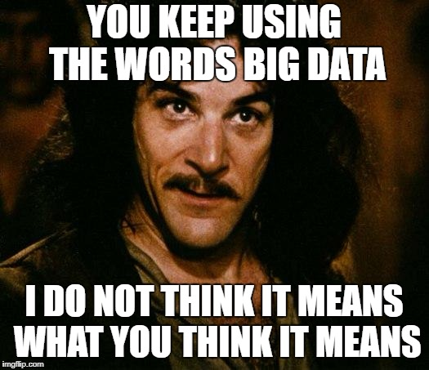
Endpoint Problem
Detection is an art form and is difficult on endpoints
What data sources matter?
How tactical is the data?
Will the data break the bank?
Is it enough data?
More data != Better detection
Tactical data = Better detection
This presentation is on endpoint logs

Slide 6
What IF? Mock Scenario of Common Malware
Initial compromise - Phishing link with malicious HTA
Privilege escalation via named pipe escalation
New local account created and added to Administrators group
Persistence established via reboot registry key
Credentials stolen and reused to pivot internally
Adversary or malware crawls systems looking for credit cards
Data compressed, encrypted, and then exfiltrated over encrypted connection

Slide 7
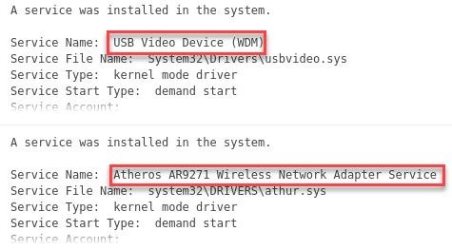
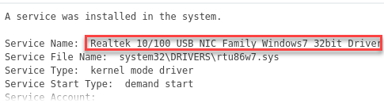
New Service Creation
Event ID: 7045 Channel: System
Detects new service installs as well as:
Unauthorized services
Wireless Adapters
Video cards
One of these is pure evil ---->

Slide 8
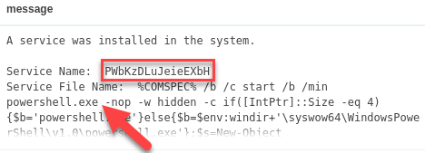
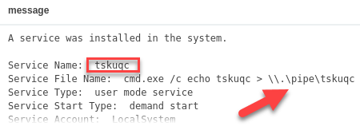
Service Creation Gone Bad
Common attack techniques create services
Top example is of Meterpreter compromise through PSExec
Bottom event is of privilege escalation
Immediately after execution the services are deleted

Slide 9
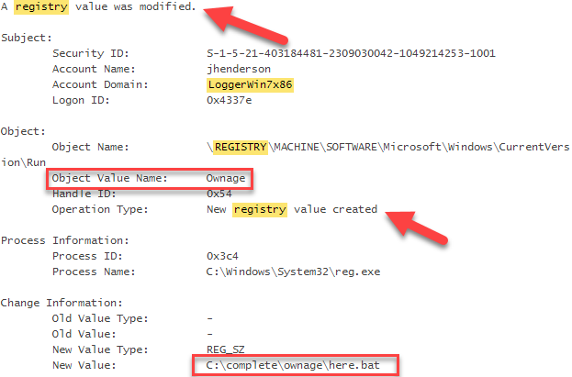
Persistence Mechanisms
Event ID: 4698, 4657 Sysmon: 13 Channel: Security
Common malware locations:
Registry keys
Scheduled Tasks
Services
Registry keys requires auditing to be enabled

Slide 10
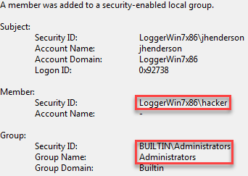
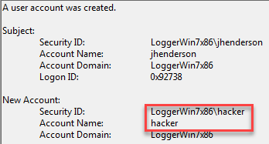
New Users and Groups
Event ID: Local user - 4720 Groups - 4728, 4732, 4756 Channel: Security
Local users tend to be static
New accounts unauthorized
Certain groups need monitored
Domain/Enterprise Admins
Local Administrators
Not on list… Unauthorized

Slide 11
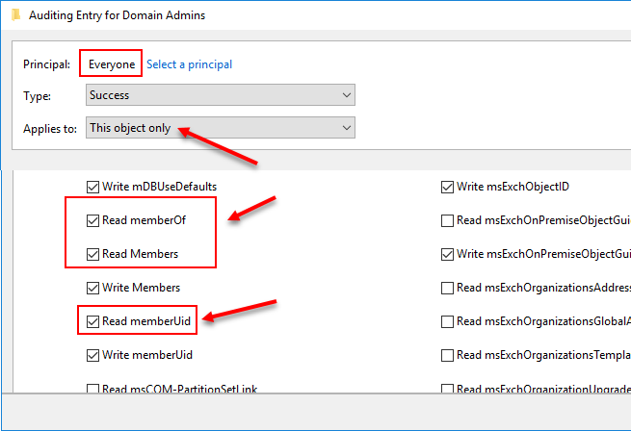
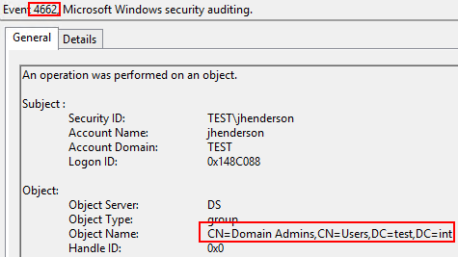
Auditing Group Member Read Requests

Slide 12

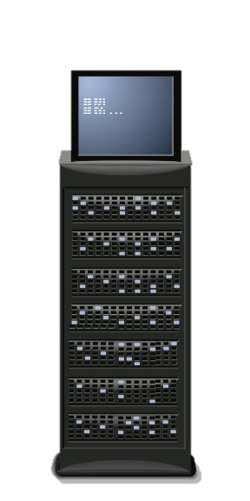


Controlled Authentication
Policy may dictate that sensitive accounts must be used from central system (jump box or software solution)
Combined with logon type can be powerful alert
Example: Domain admins must come from jump box
Logon type: 3 Source 10.5.55.3
Logon type: 3 Source 10.5.55.4 X
X
10.5.55.3
10.5.55.2
Jumpbox
DC
10.5.55.4

Slide 13

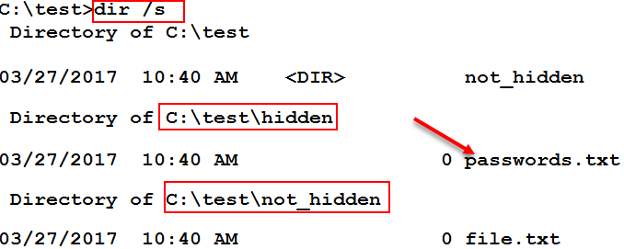
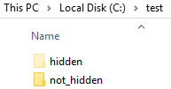
Tactical Endpoint Data
Event ID: 4663 (works with 4657 and 13) Channel: Security
Files can be added to system with auditing
Purpose is to never be touched

Slide 14
Linux Tactical Monitoring - auditd
# First rule - delete all
-D
# Increase the buffers to survive stress events.
# Make this bigger for busy systems
-b 320
-a exit,always -F arch=b64 -S sethostname -S setdomainname -k testrule1
-w /etc/credit_cards.csv -p wa -k NOTOUCHYCC
-w /etc/passwd -p wa -k NOTOUCHYPASSWD
Example auditd config

Slide 15
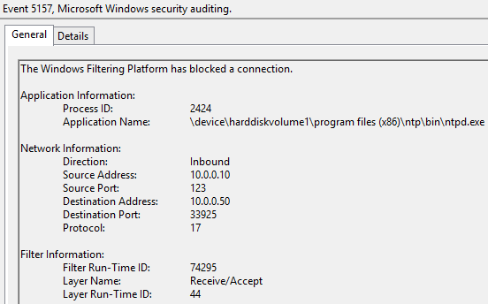
Blocked Connection Example
Event ID: 5154, 5156, 5157, 5158
Channel: Security
Firewalls provide a wealth of information
Source/Destination
Application
Direction
Block (5157)/Allow (5156)/Listen (5154 and 5158)
How many applications are authorized to listen on a desktop?

Slide 16

Summary
Endpoint logs are fairly extensive in detection capabilities
Does not have to be big data for actionable detection
But you must have the right data
And the right people handling the data
Also, check out SEC555: SIEM and Tactical Analytics

Slide 17
Blue Team Summit & Training
Save the Date: April 23 - 30 Louisville, Kentucky
sans.org/BlueTeam
SEC530 – Defensible Security Architecture
SEC555 – SIEM with Tactical Analytics
SEC511 – Continuous Monitoring & Security Operations
MGT517 - Managing Security Operations
Cyber Defense NetWars
SUMMIT
April 23-24
TRAINING
April 25-30
sans.org/BlueTeam
Notes:
Drag Picture and Send to Back

